Slide 1
Chapter Five
Business Process Engineering
Notes:
Business : Work done for serving customers in a commercial or non-commercial activity
Process : A series of actions or steps towards achieving a particular end. [in this case the end is business goal]; Some processes may take very long time to complete.
Engineering is the application of science in the planning, design, construction, and maintenance of buildings, machines, and other manufactured things. Engineering is about getting results of the required quality and functionality within schedule and budget.
It is about finding appropriate solutions to business problems.
All three require time, space, human effort, and money to fulfill requirements of customers.
The objective of this chapter is learning about the delivery of software products using engineering; Software Engineering.
It is about solving business problems with software by applying principles of science (engineering).

Slide 2
Outline
Definitions
Phases of Software Development Life Cycle
SDLC Models (Software Development Process Models)
Notes:
Life Cycle : the complete process of development and change during something's lifetime.
What is a model? An abstraction of a complex phenomena (that some one might follow as a good practice).
A simplified view of complex reality.
SDLC models : Simplified views of SW development processes that SW developers choose to follow.
Process -> activities (phases) -> tasks -> techniques (and tools)

Slide 3
Definitions
A process is a specific ordering of work activities across time and space, with a beginning, an end, and clearly identified inputs and outputs: a structure for action.
A business process is a group of logically related tasks that use the firm’s resources to provide customer-oriented results in support of organization’s objectives. A business process is like the DNA of a company.
Notes:
Process tells us what and when work activities are to be done in some endeavor (attempt).
Supporting or underling structure: Framework
Software process—a coherent set of activities for software production.
Process -> activities (phases) -> tasks -> techniques (and tools)
Organizational DNA gives leverage over competitors because it is done differently.
If done efficiently, in less time, lower cost, in a different way that adds value to the service.
Coherent : holding together to form a whole
Logical : Expected or reasonable under the circumstances

Slide 4
Definitions Cont.…
Business Process Engineering focuses (in our case) on automating business processes with software and on assisting the analysis, design, implementation, control, maintenance, and optimization of software development process and ensure success.
Also called
Business process Re-engineering
Business process Re-design (to reduce cost and/or add more value)
Notes:
Control accounts to umbrella activities like project management.
Engineering is about getting the work done within schedule, budget and scope through following well proven scientific techniques and good practices (lessons learned).
Individual approaches to software development did not scale up to large and complex software systems.
This will result to unreliable product, to cost more than expected, and to be delivered late.
Application of science to designing things ::> the application of science in the planning, design, control, construction, and maintenance of buildings, machines, and other manufactured things
Optimization : Make the best or effective use of a resource.
The triple constraint!
Process engineering involves translating the needs of the customer into typically production facilities that convert raw materials into value added components that are transported to the next stage of the supply chain.

Slide 5
Definitions Cont.…
Software engineering is an important and critical discipline concerned with cost effective software development.
It is based on a systematic approach that uses appropriate tools and techniques, operates under specific constraints and most importantly follows a process.
Read about triple constraint (project management, an umbrella activity)
Notes:
Systematic : methodical, according to a well thought plan, well organized.
Software product and development process. Deliverables (also called Artifacts)
Triple constraint: Cost, Scope, and Time; [Budget, Tasks, and Schedule]
There are always tradeoffs to be made under several practical situations.
Cost-effective : Effective or productive in relation to its cost.
Software engineering is an engineering discipline which is concerned with all aspects of software production.

Slide 6
The IEEE definition
Software Engineering:
The application of a systematic, disciplined, quantifiable approach to the development, operation, and maintenance of software; that is, the application of engineering to software.
The study of approaches as in 1)
Notes:
All aspects of software production: Software engineering is not just concerned with the technical processes of software development. It also includes activities such as software project management and the development of tools, methods, and theories to support software development.
Systematic : methodical, according to a well thought plan
Disciplined : Showing a controlled form of behavior or way of working.
Software engineering is the art (creativity) and science of developing reliable software systems that address customer needs, subject to resource, business, and societal constraints.
Programming without following software engineering rules is hacking! Hack = somehow manage or get along
SSAD: Structured Systems Analysis and Design
OOSE: Object Oriented Software Engineering (OOA, OOD, OOP, OOT)
CASE tools: Computer aided Software Engineering tools
MDE: Model driven engineering & BPEL
N.B. : MS Visual Studio and J2EE are Graphical (Windows) IDEs and Enterprise Application Platforms.
They are lower-CASE Tools! Have some features: Programming, Debugging, and a few more services.
Systemic : result of the interaction between the components of a system (me)
: built-in, inherent, Structural

Slide 7
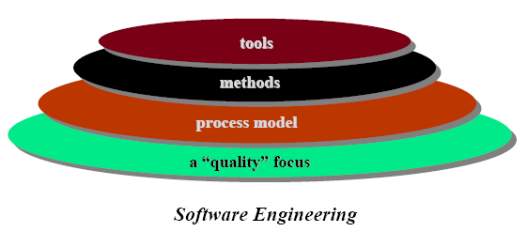
A Layered Technology
Org. Culture
Roger S. Pressman
Notes:
According to Pressman Software Engineering is seen as a Layered Technology
The bedrock is Organizational commitment to quality. A Continuous process improvement organizational culture. (Six Sigma, Kaizen) [Architecture, Framework, Container]
The foundation for SW engineering is the process layer represented by an appropriate process model.
Methods provide the technical how-to(s) for building software.
Software engineering tools provide automated or semi-automated support for the process and the methods.
Tools: for example, CASE tools; Methods: A set of well tested and proven techniques
Process model (framework): waterfall, spiral, agile, open source
Programming without software engineering is hacking! Hack = somehow manage or get along
??Methodology (process model + methods + tools) example OOSE??
UML provides the visual modeling syntax for OO modeling, and UP provides the software engineering process framework that tells us how we perform OO analysis and design. (UML and UP book preface)

Slide 8
What is CASE (Computer-Aided Software Engineering)
Software systems which are intended to provide automated support for software process activities
Upper-CASE
Tools to support the early process activities of planning, requirements and design
Lower-CASE
Tools to support later activities such as programming, debugging and testing
Notes:
These are software tools that make the life of the developer easy and facilitate the development process.
CASE tools, Example IDEs
What tools are integrated in programming IDEs like Code-blocks or Dev C++?
Editor, Compiler, Debugger, Linker, and Loader?
What does the loader do?
Upper CASE tools : Microsoft project, Microsoft VISIO, IBM’s Rational rose, etc.
Lower CASE tools : J2EE, Microsoft Visual Studio, etc.
Microsoft word and Excel can be considered as upper case tools (or Documentation tools)
CASE can also be called Computer-Assisted Software Engineering

Slide 9
Software System development process
Software System development process contains fundamental activities or phases.
These phases are: Requirements engineering (As-Is), followed by System Design (To-Be), Implementation, Verification and Validation, and finally Maintenance.
Professor Barry Boehm
Notes:
The What and When of Software Development phases. Who does what and when?
Entry and Exit criteria / Preconditions and Post-conditions for each phase.
Sequencing or Ordering of phases.
So what can you say about System Design?
You remember, a system contains many interacting components.
Software product and development process. Deliverables (also called Artifacts)
Deliverables are products or outputs and can be inputs to the next phase.
Fundamental : General (Generic)
What is a model? An abstraction of a complex phenomena (that some one might follow as a good practice). A simplified view of complex reality.

Slide 10
Software System development process phases: SDLC phases
Requirements Engineering: is the process of establishing the needs of stakeholders that are to be solved by software.
Why is this phase so important? In general the
cost of correcting an error depends on the number of subsequent decisions that are based on it. Therefore, error made in understanding requirements have the potential for greater cost because many design and other following phase
decisions depend on RE results.
Notes:
** Understand the problem before you build a solution.
Engineer (verb): skillfully arrange for something to occur ➔ skillfully extract user requirements
Life Cycle : the complete process of development and change during something's lifetime.
This phase is done by the system analyst or software engineer.
Also called requirements elicitation and analysis.
Software solutions to business problems

Slide 11
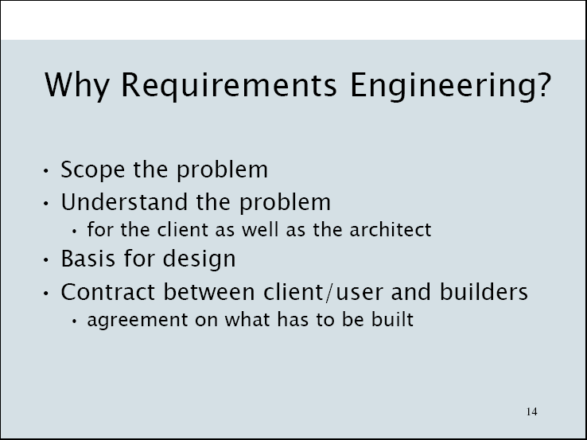
Notes:
Sign off / Sign up;

Slide 12
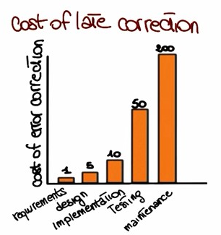
Notes:
The early you can find a problem in your development, the cheaper, easier, and less disruptive it will be to fix.

Slide 13
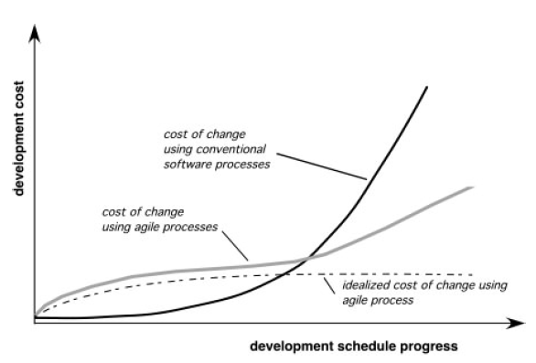
Agility and the Cost of Change
Notes:
Since cost of change is expensive, we need appropriate process models like agile process, in that respect at least for some problem domains (application types).
Agility is the ability to change easily. The ability to quickly adapt to changes.
Agile process is one of the process models.

Slide 14
Requirements Engineering Cont…
Also called requirements elicitation and analysis
How can we collect the right requirements? Traditional requirements engineering does so through a set of steps: The first step is Elicitation which is the collection of requirements from stakeholders and other sources and can be done in a variety of ways (methods) [through questionnaire survey, interview, brainstorming, using prototype, document analysis, work place observation, and so on]
Notes:
Brainstorming: Produce an idea or solution by having a group discussion
Products or deliverables are the outcomes of a process activity
Prototype: Showing only few functionalities (samples), scaled down version of something
There are two flavors: Disposable and Evolutionary (here we most likely mean the disposable)
Elicitation : Extracting, Obtaining;
Artifacts, and Deliverables; → For example in OOSE, use case, sequence, and class diagrams
Survey: Investigate the opinions or experience of a group of people by asking them questions
Functional and nonfunctional (quality) requirements may be good to be discussed here!
Performance, security, usability, agility, availability, recoverability, portability, and so on.
Model: A simplified view, Abstract view of something complex.

Slide 15
Requirements Engineering Cont…
The second step is requirements analysis which involves the study and deeper understanding of the collected requirements.
Structuring (modeling) of system requirements is also part of this activity.
The third one is the specification of requirements in which the collected requirements are suitably represented organized and saved so that they can be shared (SRS).
They can be validated and delivered (as SRS).
Requirements management may account to changes to requirements during the life time of the project.
Notes:
Analysis: Detailed examination of the elements or structure of something. (contrast with synthesis)
Validated to make sure that they are complete, consistent, and no redundancy (no duplication).
SRS: Software requirements specification
There shall be a sign off : Agreement should be signed before proceeding
The analysis phase is concerned with what must be done,
and the design phase is concerned with how it will be done.
Consistence: coherence: reasonably or logically harmonious.
What makes software engineering different from problem solving in other sciences is that change occurs in the application and the solution domain while the problem is being solved. (Bruegge)

Slide 16
System Design
It is the phase where the description of the internal structure and organization of the system are produced and this description will serve as the basis for the construction of the actual system.
Design activities normally consist of architectural design, abstract specification, interface design, component or subsystem design, persistent data management, and so on.
These activities result in a set of design products which describe various characteristics of the system.
Notes:
The analysis phase is concerned with what must be done, and the design phase is concerned with how it should be done.
Design goal decisions, access control lists, and design classes might be considered as Software Design specifications.
What is the name for the internal structure and organization of a system? Architecture.
Organization: Systematic arrangement of elements (components)
Abstract specification: a written summary of specifications
Class diagrams, HW/SW mapping diagrams, Architecture diagrams, etc.
Both software architecture and the architecture of buildings are concerned largely with structural issues. However, software architecture is even more complicated than building architecture because software applications are not static once they are constructed. They grow continuously at about 8 percent per year as new features are added. This is much faster than buildings grow once complete. Also, software applications have no value unless they are operating.

Slide 17
Implementation
Here what we do is basically realizing the design of the system that we just created and create an actual software system.
There are four fundamental principles or pillars that can affect the way software is constructed.
The first is the reduction of complexity (Usability).
The second is the anticipation of diversity (Agility).
The third pillar is the structuring for validation (Testability).
Finally it is important that the SW conforms to standards (Interoperability and other issues).
Notes:
Implementation: Construction
Reduction of complexity aims to build software that is easier to understand and use.
Usability : ➔ How easy it is for end users to learn and to use the software (Learnability)
Agility takes into account future changes, that SW evolves.
Agility is the ability to change easily. The ability to quickly adapt to changes.
Structuring for validation also called Design for testability.
That the SW conforms To internal and external standards, Organization and Government standards (quality standards in addition to the above).
Coding and Documentation standards, user interface standards, SW and HW platforms to work on (OS types), type of programing language to be used

Slide 18
Verification and Validation
After we have built the system, here is the phase where we check that the software system meets its specification and fulfills its intended purpose.
Validation is the activity that answers the question, did we build the right system?
Verification answers a different question, did we build the system right? Did we build the system that actually implement the specification that we defined?
Verification can be performed at the unit level, integration level, and finally the system as a whole.
Notes:
Verification: Proof of correctness
Validation is abut true value of the system (The aggregate result)
Unit level (Procedure or object level), Integration level (component/module), and System (Service level)

Slide 19
Verification and Validation Cont.
Thus, in verification, we want to make sure that the different modules talk to each other in the right way.
During system testing, we test the system as a whole and want to make sure all the system, all the different pieces of the system work together in the right way. This is also the level at which we apply validation and some other testing techniques like stress testing or robustness testing and so on.
Notes:
Robustness testing = stress testing : testing with a set of invalid inputs to check if it crashes
Robustness : able to withstand or overcome adverse conditions.
Use stress testing in message passing systems. This means that you should design tests that generate
many more messages than are likely to occur in practice.
This is an effective way of revealing timing problems.

Slide 20
Maintenance
Software development effort normally result in the delivery of a software product that satisfies the user requirements. However, when the software is in operation many things can happen.
The environment might change (there might be new libraries, new operating systems) in which our software system has to operate.
There may be feature request that the users might want to do something different with the product that we gave them.
Or users might have problems with the software and may file bug report.
Notes:
Surveys confirmed that maintenance costs outweigh development costs.
Adaptive maintenance
Perfective maintenance
Corrective maintenance
Feature: Bahri; Function: Tegbar
A function is a goal that can be accomplished with a product, service, process, practice, system, application, document, component, machine or environment. ... A feature is a tool that helps to accomplish functions. For example, the wheels of an aircraft are features that support functions such as landing and taking off.
Both software architecture and the architecture of buildings are concerned largely with structural issues. However, software architecture is even more complicated than building architecture because software applications are not static once they are constructed. They grow continuously at about 8 percent per year as new features are added. This is much faster than buildings grow once complete. Also, software applications have no value unless they are operating.

Slide 21
Maintenance Cont.
Software maintenance is the activity that sustains the software product as it evolves throughout its lifecycle.
Development organizations should perform three kinds of maintenance activities:
Corrective maintenance to eliminate problems with the code (bug).
Perfective maintenance to accommodate feature requests (and in some cases just to improve the software for example to make it more efficient, refactoring).
Adaptive maintenance to take care of environment changes.
Notes:
Refactoring is a kind of Perfective maintenance.
Refactoring is changing piece of code or algorithm to tweak a program.
Refactoring techniques can be used during minor changes.
Patch - Publicly released update to fix a known bug/issue.
Software Maintenance Categories
Correction Enhancement
Proactive Preventive Perfective
Reactive Corrective Adaptive

Slide 22
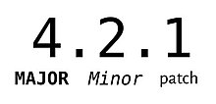
Maintenance Cont.
And after these activities have been performed, the software developer will produce a new version of the application and will release it and the cycle will continue throughout the lifetime of the software.
That is why maintenance is a fundamental activity and very expensive one.
One of the reasons, in addition to the reasons in the previous slide, why maintenance is expensive is regression testing. Regression testing is the activity of retesting software after it has been modified.
Notes:
Surveys confirmed that maintenance costs outweigh development costs.
What does change to its parts introduce to a system? Side-effects
Regression testing — re-running previous tests to check that changes to the program have not introduced new bugs. (Checking for side effects)
Patch - Publicly released update to fix a known bug/issue.
Version & Release & Product

Slide 23
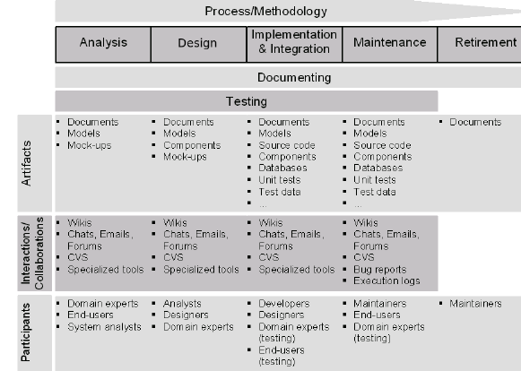
Notes:
Mock-ups : a model or replica of a machine or structure, used for instructional or experimental purposes
Mock-ups : User Interface sketches
There is a wide range of prototyping techniques—from paper mockups of screen designs to beta-test versions of software products—and a strong overlap of their separate uses for requirements elicitation and for requirements validation
CVS : Concurrent Versioning System, is a free client-server revision control system in the field of software development.
➔ A collaboration tool
Wiki : A website or database developed collaboratively by a community of users, allowing any user to add and edit content.
→ Example Wikipedia
→ A kind of collaboration platform.

Slide 24
Process flow is determined by the process model or framework that we choose for development
Roger S. Pressman
Notes:
Software process models
1. Determine the order of phases;
X → Y → Z or Y → Z → X and
2. Establish the transition criteria X →?→ Z as prescribed by the model;
→ Entry criteria and Exit criteria
Is there any deliverable? Can they go in parallel somewhere? Any pre and post conditions?

Slide 25
The Prototyping Paradigm or model
Notes:
Other possible phases are risk assessment (part of Spiral model) and prototype
Prototyping: Making a quick and diminished version of a SW product
>> Can be used to guide design decisions
A Prototype can be used for → Requirements elicitation and also for
→ Testing : Beta versions are released before full versions.
→ Alpha testing (given to small groups) and Beta testing (given for large groups)
Can be taken as a possible phase of other models (to gather requirements)
2.1.5 one major difference and 5 minor features from 2.0
*Disposable and Evolutionary Prototype

Slide 26
Assignment:
Make a research on SDLC process models and write your findings. Specify the advantages and disadvantages of each model. Identify and list artifacts produced in phases of each model, and describe entry and exit criteria. You should include the open source model in your discussion.
Make a thorough investigation about software CASE tools and write your findings.
Reading Assignment:
Read Chapter 2 of the book “Software Engineering, A Practitioner’s Approach, 8th Edition, Roger Pressman”
Notes:
Work in groups of three.

